Slide 1
Machine Learning
Guan Wang
Week 11

Slide 2
Machine Learning Definitions
Machine learning is process (field of study) that gives computers ability to learn without being explicitly programmed.
A.L. Samuel Some Studies in Machine Learning Using the Game of Checkers // IBM Journal. July 1959. P. 210–229.
A computer program is said to be learn from experience E with respect to some task T and some performance measure P, if its performance on T, as measured by P, improves with experience E.
T.M. Mitchell Machine Learning. McGraw-Hill, 1997.

Slide 3
Required Background (Optional)
Probability theory and mathematical statistics
Optimization
Computational science
Linear algebra
Discrete math
Computational complexity theory
...

Slide 4
Machine Learning Problems
Supervised Learning
Unsupervised Learning
Semi-supervised Learning
Deep Learning
Reinforcement Learning
Federate Learning
…

Slide 5



Concepts
Dataset
Sample / Example
Feature / Attribute
Answer / Label
Model
Algorithm
input
model
output
$$x$$
f (x, θ*)
$y$ / $p(y|x)$
dataset
A
$${\{x^{i},y^{i}\} }_{i=1}^{N}$$
algorithm

Slide 6
Supervised Learning
Supervised algorithms are trained on labeled examples (samples), such as an input where the desired answer is known.
Classification (Discrete)
Regression (Continuous)
…
For example, a segment of text could have a category label, such as
Spam vs. Legitimate emails
Positive vs. Negative movie reviews

Slide 7
Supervised Learning
The model receives a set of inputs along with the corresponding correct outputs, and the algorithms learns by comparing its actual output (predicts) with correct outputs (labels) to find errors
It then modify the parameters of the model accordingly

Slide 8
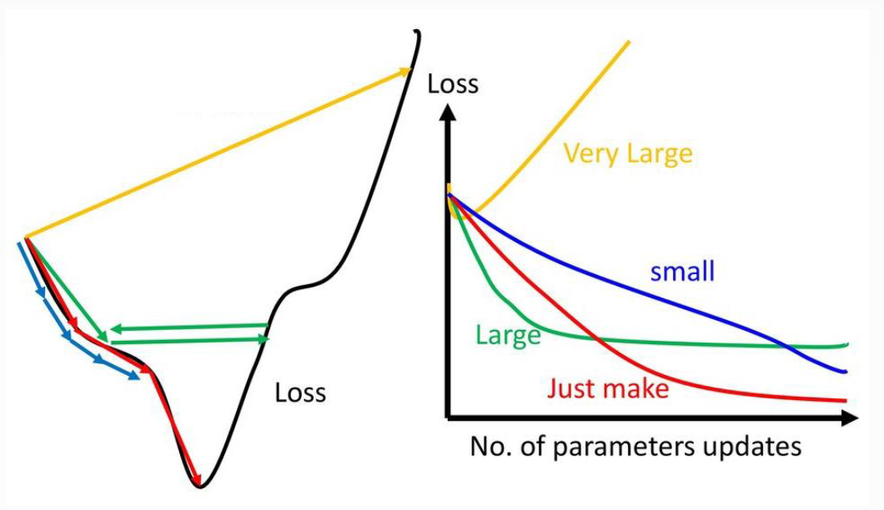
Factors of Supervised Learning
Model
Linear
Non-linear
Loss Function
0-1 loss function
Quadratic loss function
Cross-Entropy loss function
Optimization Algorithm
Gradient Descent
Learning Rate

Slide 9
Example: Regression
Price ($)
In 1000’s
Size in meter²

Slide 10
Example: Classification
Benign
Malignant

Slide 11
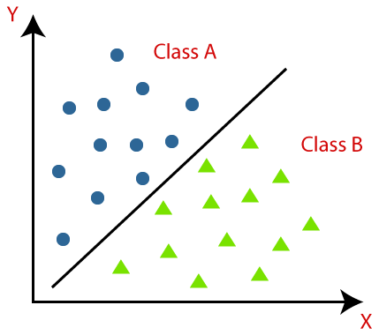
Example: Classification

Slide 12


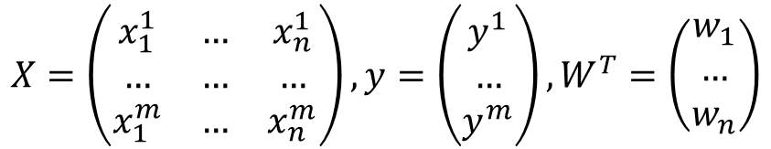
Linear Regression
$$f\left(x;w,b\right)=wx+b$$
$$f\left(x_{1},x_{2};w_{1},w_{2},b\right)=w_{1}x_{1}+w_{2}x_{2}+b$$
$$X=\left(\begin{matrix}x_{1}^{1} & … & x_{n}^{1} \\ … & … & … \\ x_{1}^{m} & … & x_{n}^{m}\end{matrix}\right),y=\left(\begin{matrix}y^{1} \\ … \\ y^{m}\end{matrix}\right),W^{T}=\left(\begin{matrix}w_{1} \\ … \\ w_{n}\end{matrix}\right)$$
$$f\left(X;W,b\right)=W^{T}X+b$$
$$y^{i}=f\left(X^{i};W,b\right)={w_{1}x}_{1}^{i}+{w_{2}x}_{2}^{i}+…+{w_{n}x}_{n}^{i}+b$$

Slide 13
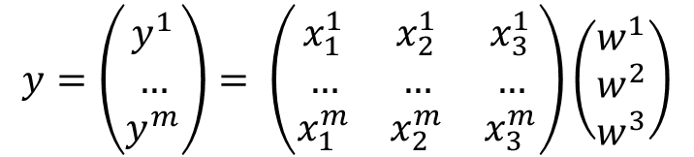
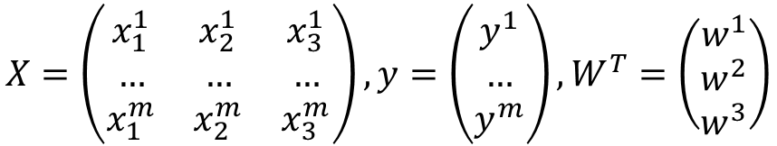
$$X=\left(\begin{matrix}x_{1}^{1} & x_{2}^{1} & x_{3}^{1} \\ … & … & … \\ x_{1}^{m} & x_{2}^{m} & x_{3}^{m}\end{matrix}\right),y=\left(\begin{matrix}y^{1} \\ … \\ y^{m}\end{matrix}\right),W^{T}=\left(\begin{matrix}w^{1} \\ w^{2} \\ w^{3}\end{matrix}\right)$$
$$y=\left(\begin{matrix}y^{1} \\ … \\ y^{m}\end{matrix}\right)= \left(\begin{matrix}x_{1}^{1} & x_{2}^{1} & x_{3}^{1} \\ … & … & … \\ x_{1}^{m} & x_{2}^{m} & x_{3}^{m}\end{matrix}\right)\left(\begin{matrix}w^{1} \\ w^{2} \\ w^{3}\end{matrix}\right)$$

Slide 14

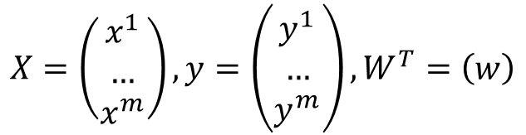
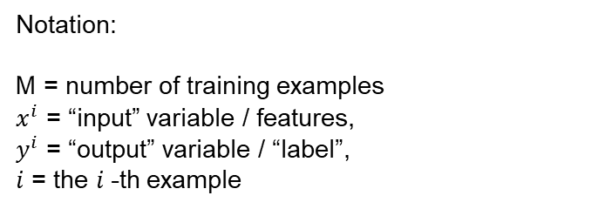
Area (x) | Price($) in million (y)
742 | 1.33
896 | 1.22
996 | 1.22
750 | 1.22
742 | 1.14
… | …
$$X=\left(\begin{matrix}x^{1} \\ … \\ x^{m}\end{matrix}\right),y=\left(\begin{matrix}y^{1} \\ … \\ y^{m}\end{matrix}\right),W^{T}=\left(w\right)$$
$$y^{i}=f\left(x^{i};w,b\right)=W^{T}x^{i}+b$$
Notation:
M = number of training examples
$x^{i}$ = “input” variable / features,
$y^{i}$ = “output” variable / “label”,
$i$ = the $i$-th example

Slide 15
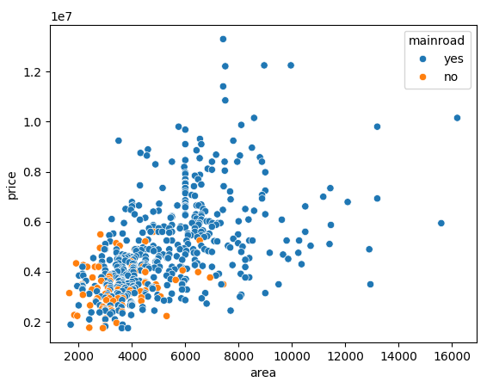
Simple Linear Regression
Supervised Learning
Given the “right answer” or “label” for each example in the data
Regression Problem
Predict real-value output

Slide 16



Input $x$
model
Output $y$
Area of the house
f (x, W)
Estimated price
dataset
A
$${\{x^{i},y^{i}\} }_{i=1}^{N}$$
Learning algorithm

Slide 17
Scikit-learn
https://scikit-learn.org/stable/index.html

